Slide 1

Land Value Tax API
Jacob Barron COMP3011 – Web Services and Web Data

Slide 2
Motivation
Land value taxes - “The only good tax”
Discourages land speculation
Encourages value production, which isn’t taxed This API:
- toolbox for the calculation of land value taxes based on location and property information.
- provide a programmatic interface to explore and evaluate land value taxes specifically for residential properties, with an ultimate aim to explore the feasibility of land value taxes.

Slide 3
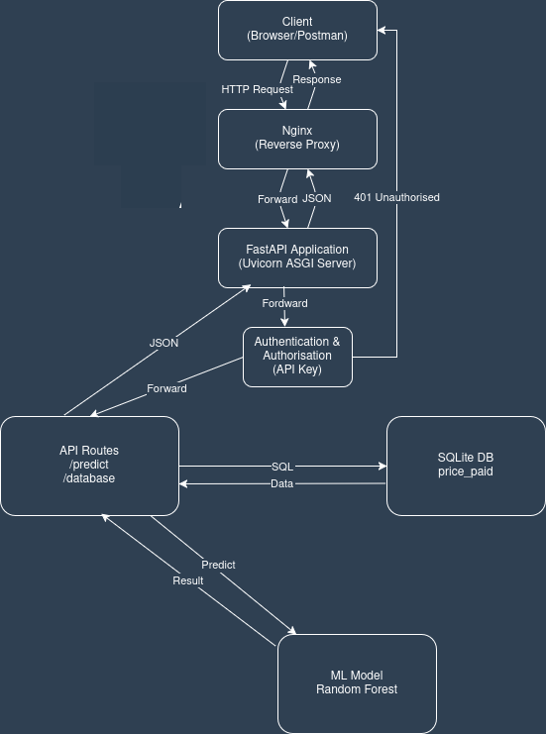
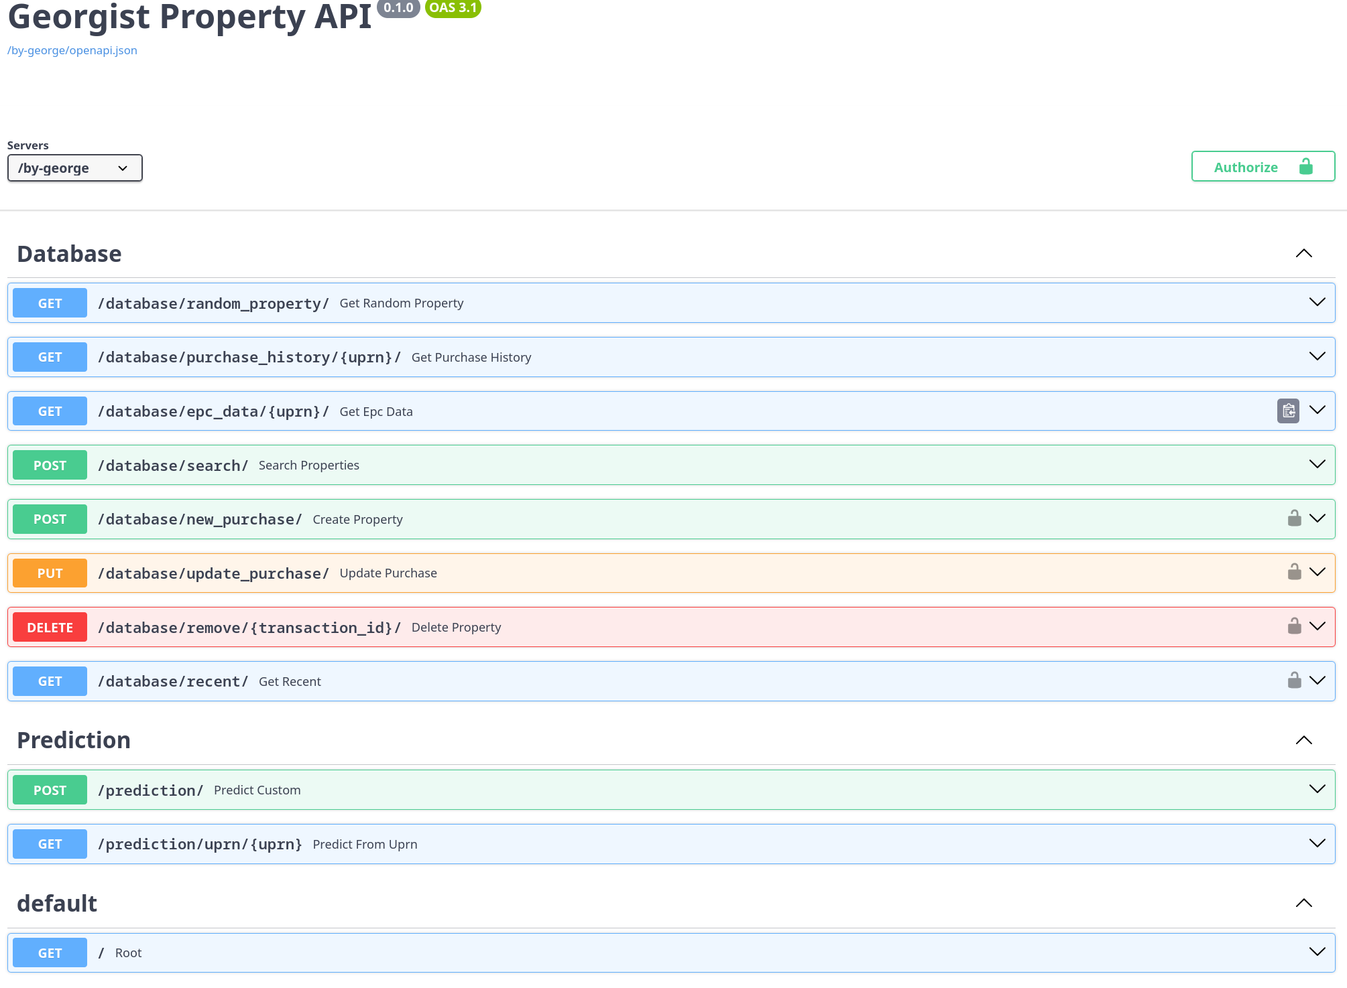
API Design and functionality
Reverse proxy – nginx
Web framework and authorisation – FastAPI
Database – SQLite
Regression model – Scikit-learn

Slide 4
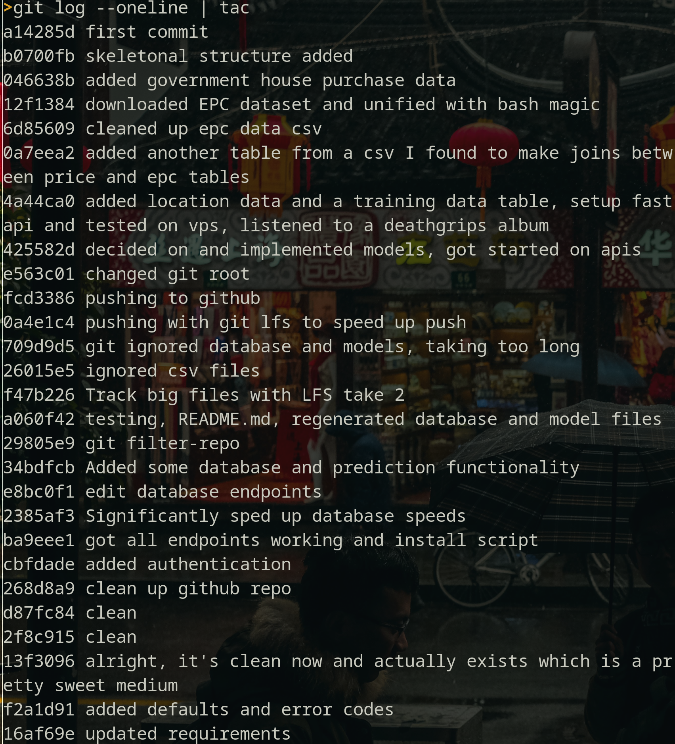
Development and AI
Process of AI in chosing the regression model (a highlight from the techical report)
“I would like to highlight how the use of AI played into the process of finding and deciding on the dual model hedonic approach for land value calculation. Under the assumption that the decomposition of a regression model could show how much effect a certain value such as location has on the total price, corresponding to the absolute land value, the random forest regression model was considered, due to it’s higher suitability for location data. However, upon implementing this, and decomposing using SHAP, the results were clearly wrong, sometimes negative. During the following back and forth with chat models, which like most of the many back and forths about everything from the design and implementation of the API to SQLite database access and efficiency, what it was being implemented was learnt and understood in order to evaluate different alternatives and ways frowards. Finally, the dual model hedonic approach was deem the most suitable for the task, and resulted in reasonable predictions. An excerpt of this can be seen in fig.4. “

Slide 5
Repository and Demonstration
. ├── README.md ├── app/ │ ├── auth.py │ ├── main.py │ └── routes │ ├── database.py │ └── prediction.py ├── data/ │ ├── createTDTable.py │ ├── csvfiles/ │ ├── housing.db │ ├── importcsv-database.py │ ├── building_price_model.pkl │ ├── property_price_model.pkl │ ├── regression-housing.py │ ├── regression-total-rewrite.py │ └── regression-total.py ├── documentation.pdf ├── install.sh ├── requirements.txt └── tests/

Slide 6
Q&A

